Slide 1
Event Management App
Explore the features and functionalities of our modern .NET application.

Slide 2
Introduction

Slide 3
01
homepage

Slide 4
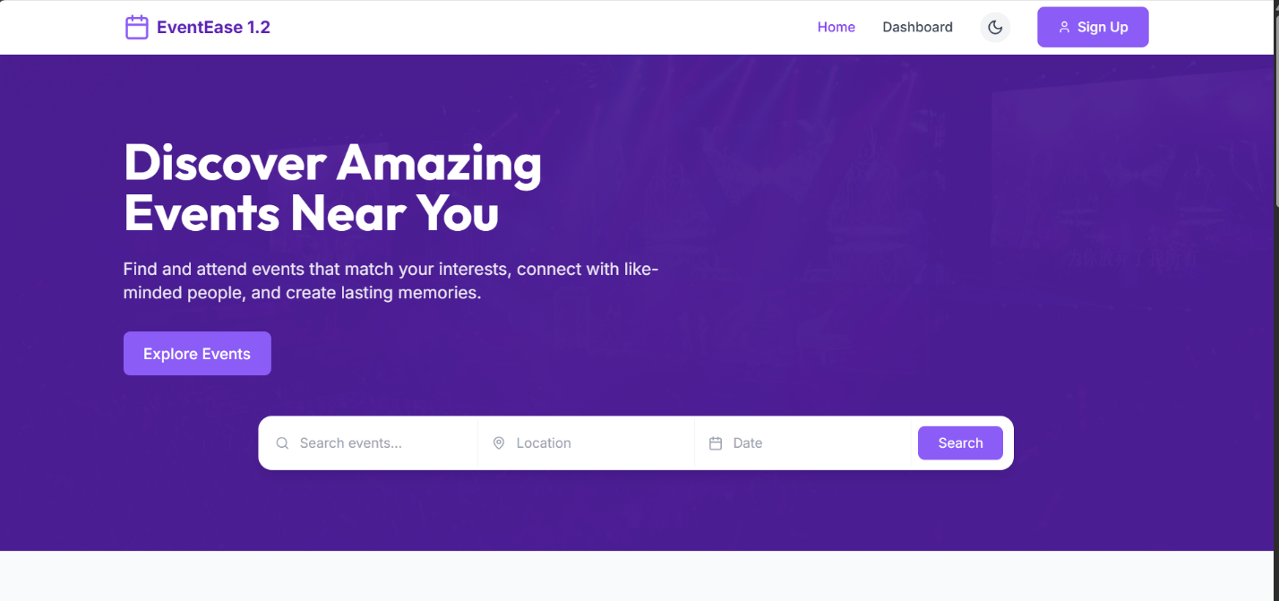
Overview of the homepage
Clean and modern UI to navigate events
Integrated search bar to quickly find events
At-a-glance overview of featured and upcoming events

Slide 5
Search Bar Functionality
The search bar allows users to quickly find events by entering keywords, enhancing user experience and accessibility.

Slide 6
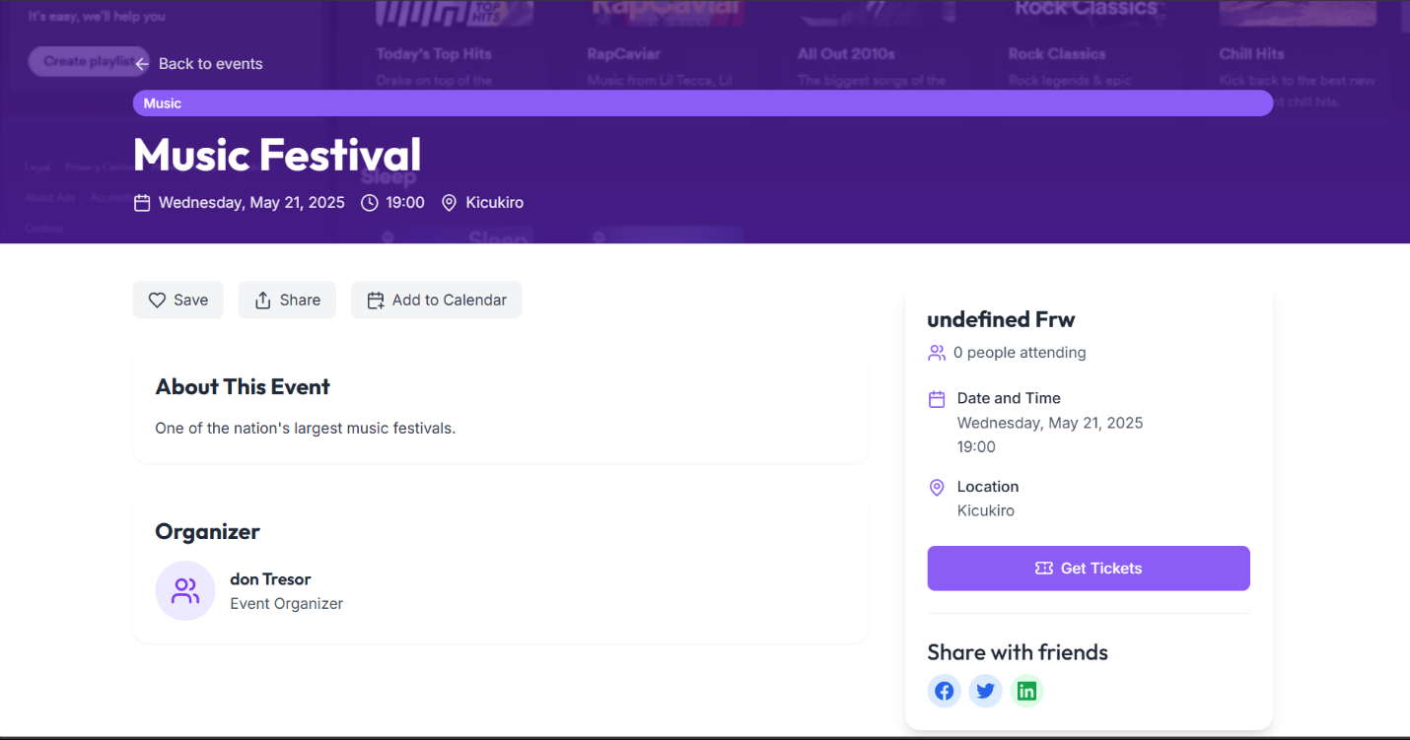
Event Summary Display

Slide 7
02
Events

Slide 8
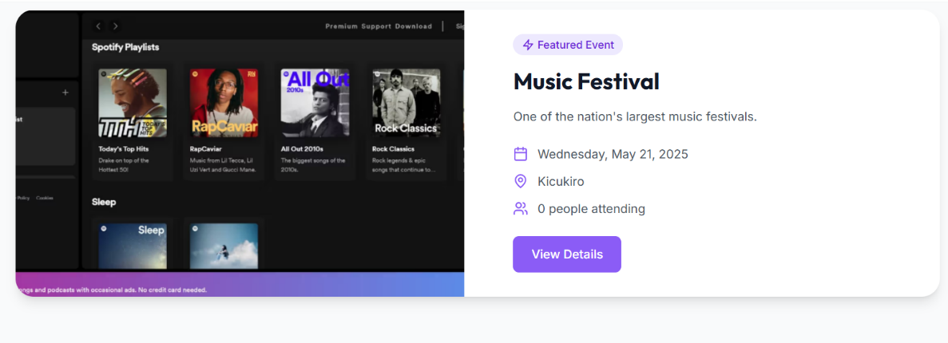
Highlighted Event Feature
Featured events are prominently displayed to attract user attention, promoting significant activities and encouraging participation.

Slide 9
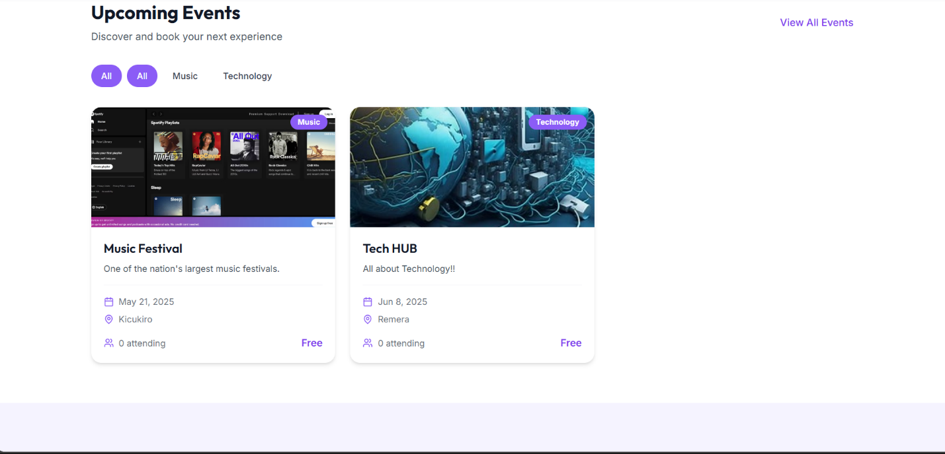
Upcoming Event Filters
Users can apply filters to browse upcoming events based on categories, dates, or popularity, making event discovery tailored and easy.

Slide 10
Event Browsing Options

Slide 11
03
User Actions

Slide 12
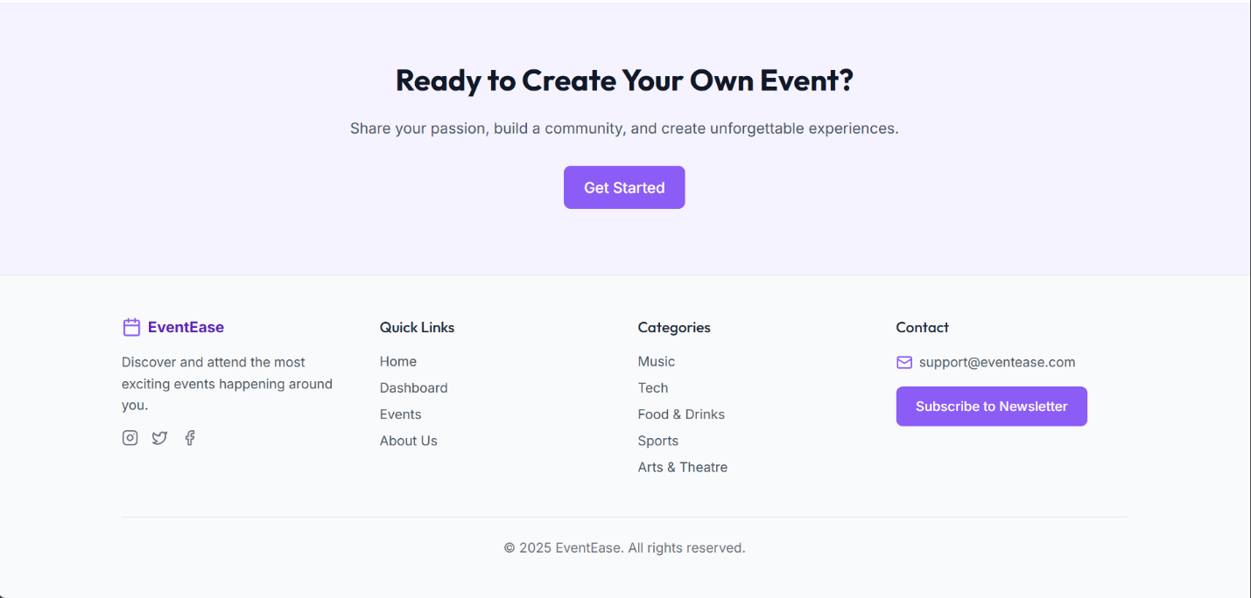
Create Your Event Call-to-Action
Encourage users to jump in and create their own events with a compelling call-to-action button. This not only promotes user engagement but also empowers them to take charge of their event experiences.

Slide 13
Footer Menu Navigation
A simple footer menu provides quick access to key areas such as home, upcoming events, user profile, and help. This intuitive navigation enhances user experience, making it easy to explore the application.

Slide 14
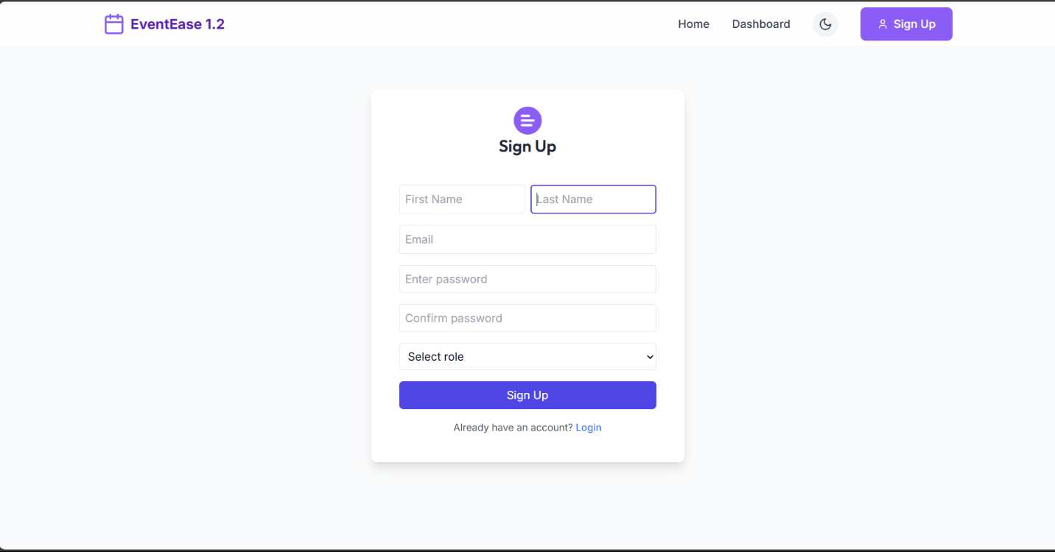
Signup Form
The signup form is designed to be user-friendly, requiring minimal information. Users can easily create their accounts with fields for name, email, and password, ensuring a quick and hassle-free registration process.

Slide 15
04
Authentication

Slide 16
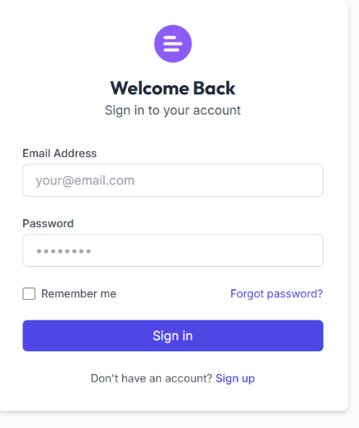
Login Form
Features:
Standard login interface with fields for email/username and password.
Includes a “Forgot Password?”

Slide 17
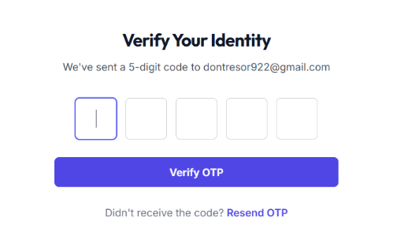
One-Time Password Verification
Features:
Implements OTP (One-Time Password) entry for secure authentication.
Adds an extra layer of security for sensitive actions and account protection.

Slide 18
05
Admin Features

Slide 19
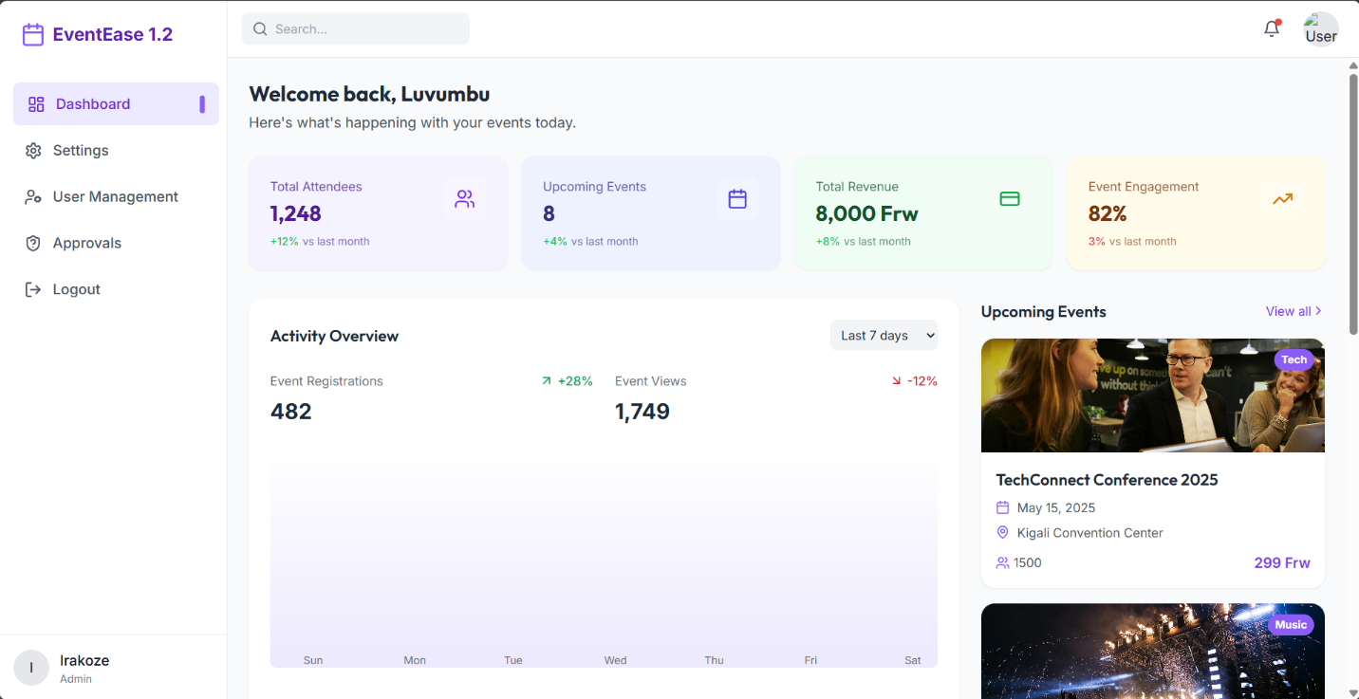
Admin Dashboard Metrics
Features:
Displays critical metrics:
Total Attendees
Upcoming Events
Total Revenue
Activity Overview
visual chart or graph.

Slide 20
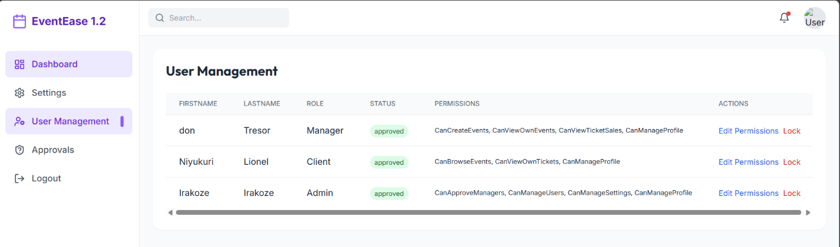
User Management Overview
Admins can view a comprehensive list of users, including their roles, status, and permissions. This facilitates effective user management and ensures that roles are properly assigned.

Slide 21
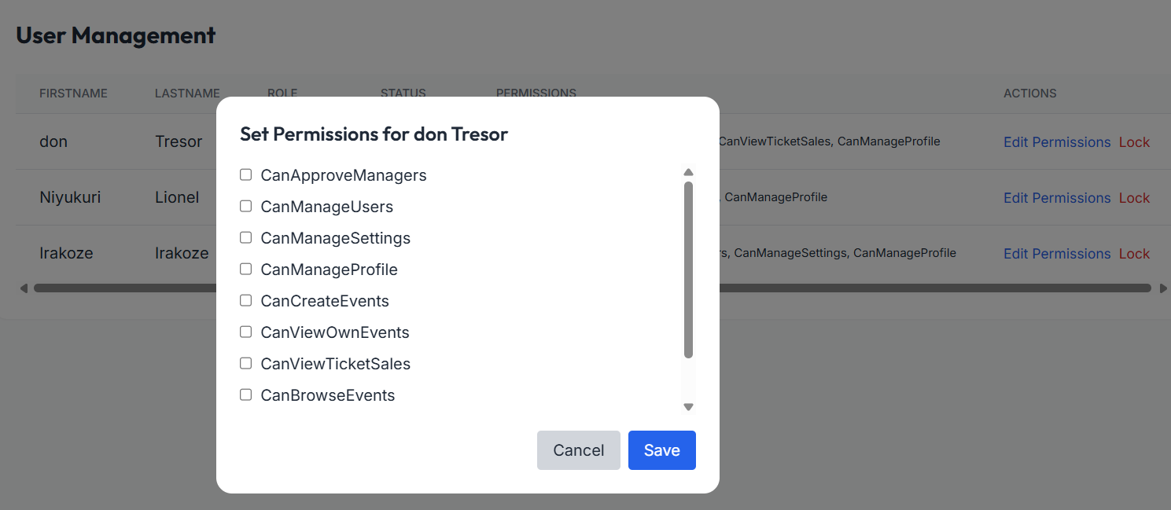
Set User Permissions
Features:
Admins can assign or modify granular permissions for individual users.
Options include:
Can approve manager applications
Can manage other users
Can create and manage events
Additional custom permission settings
Includes a Save button to apply permission changes immediately.

Slide 22
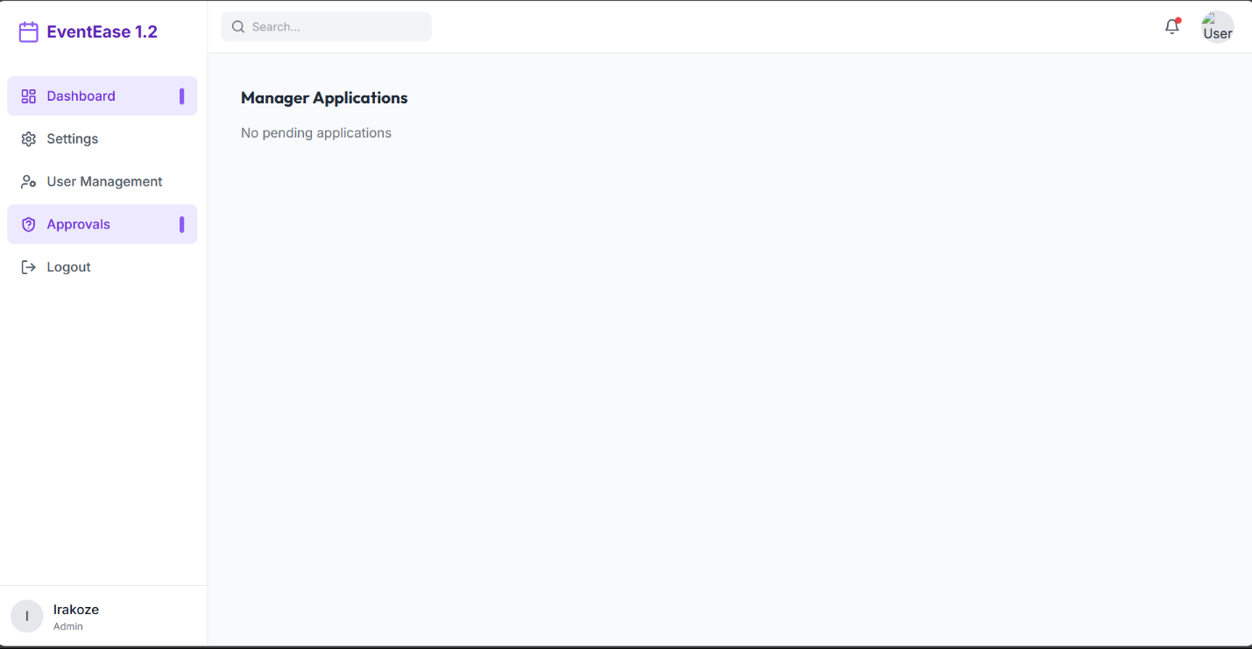
Manager Application Approvals
Features:
Displays a list of users who have requested Manager role elevation.
Admins can review and approve or reject applications.
Streamlined interface for role-based access management.

Slide 23
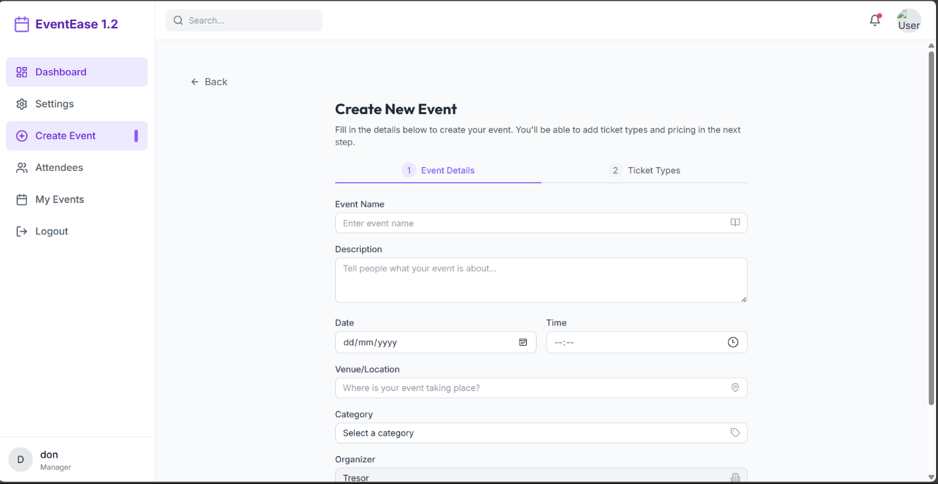
Event Creation Details (pt1- basic details)
Features:
Enables users to create new events through a structured form.
Input fields include:
Event Name
Event Description
Date and Time
Venue/Location
Event Category
Organizer Name/ID

Slide 24
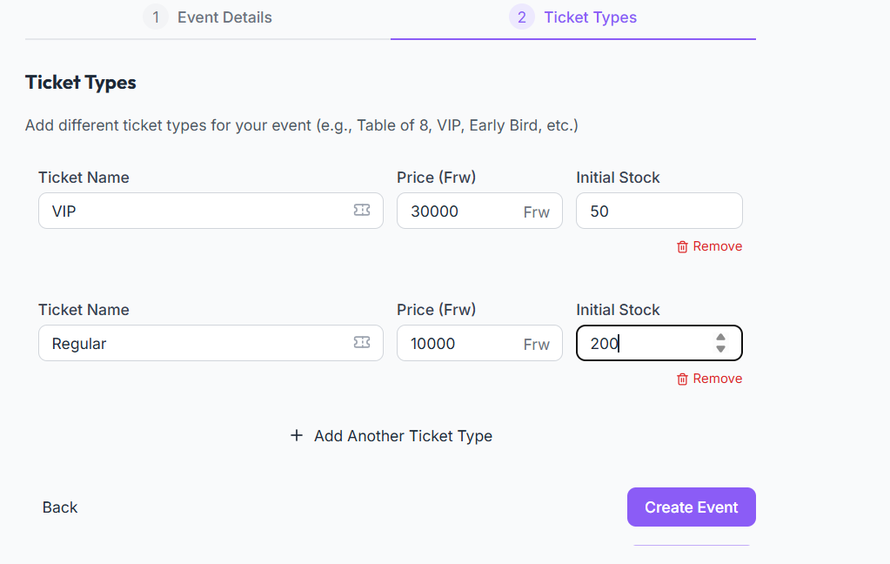
Event Creation Details (pt2- Event Ticketing)
Features:
Allows event creators to define ticket types and pricing.
Fields include:
Ticket Name (e.g., VIP, Regular)
Price per ticket
Quantity or availability
Supports multiple ticket tiers to suit different audience segments.

Slide 25
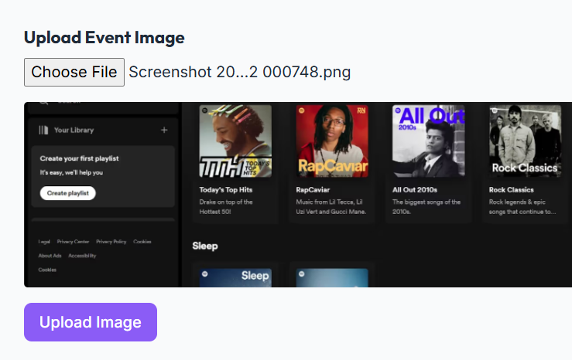
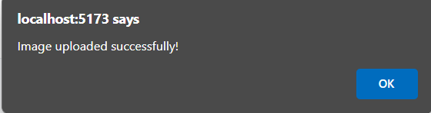
Event Creation Details (pt3- Event Ticketing)
Features:
Event creators can upload a custom thumbnail image for the event.
Enhances visual presentation on listings and promotional banners.
Supports standard image formats (JPG, PNG).

Slide 26
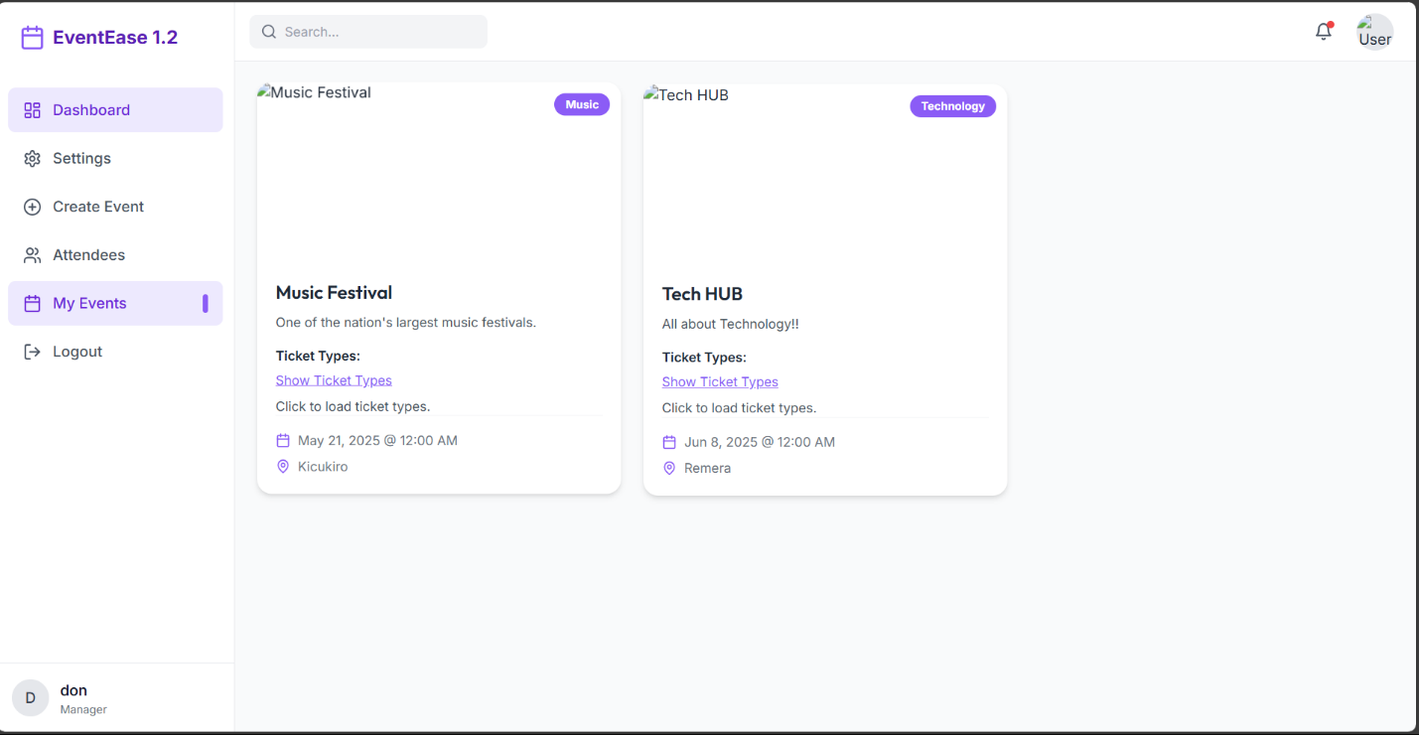
My Events
Features:
Dedicated section for organizers to manage their events.
Displays a list or grid of all events created by the logged-in organizer..

Slide 27
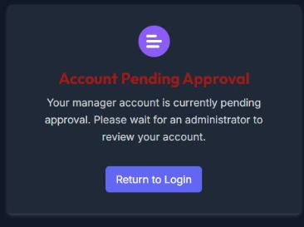
APPROVE PENDING APPROVALS OF MANAGERS FROM THE ADMIN

Slide 28
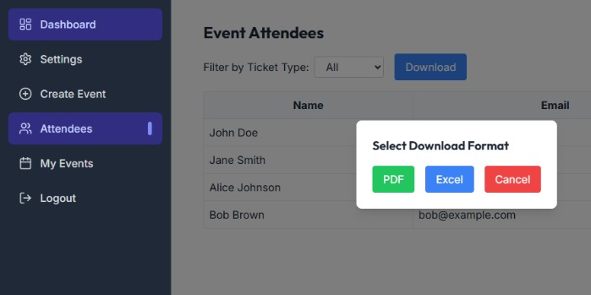
DOWNLOAD FILES IN PDF

Slide 29
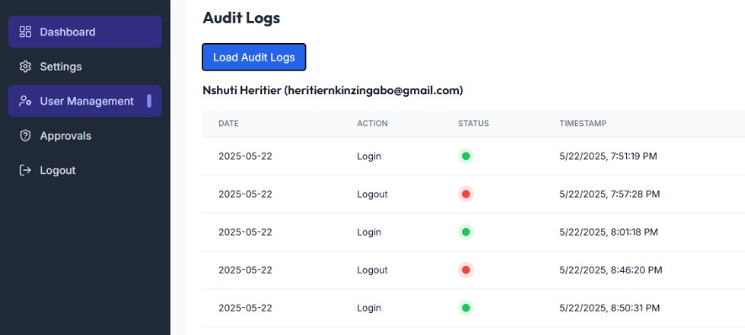
MONITORING AND AUDITING

Slide 30
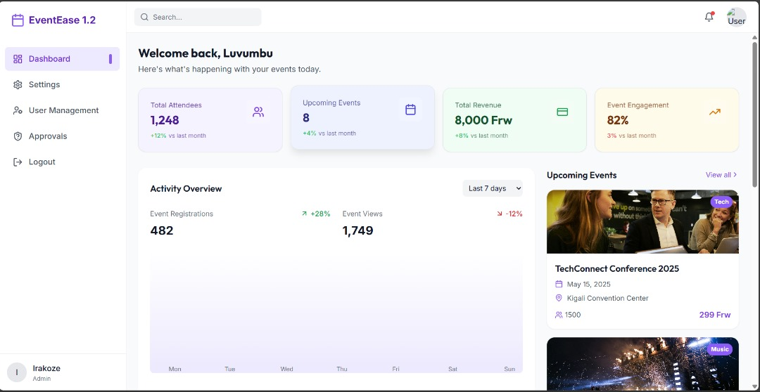
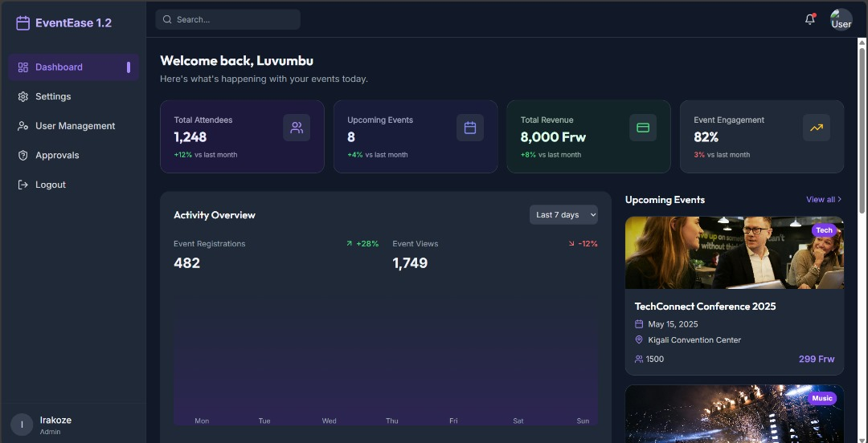
TOGGLE LIGHT MODE AND DARK MODE

Slide 31
Conclusions
In conclusion, our .NET event management application is designed to be user-friendly and feature-rich, promoting user engagement and effective event management. With intuitive navigation, secure authentication, and robust admin tools, it's the perfect solution for managing events efficiently.

